Slide 1
Sandia TLX v1.0 Install walkthrough
UNCLASSIFIED Unlimited Release
Rob Kittinger, PhD

Slide 2
Download the Sandia TLX software
Red ovals are where you will Click
Download the files from: https://github.com/luckymeef/Sandia-TLX
Hint: You may want to print this presentation because there is a PC restart half way through.

Slide 3
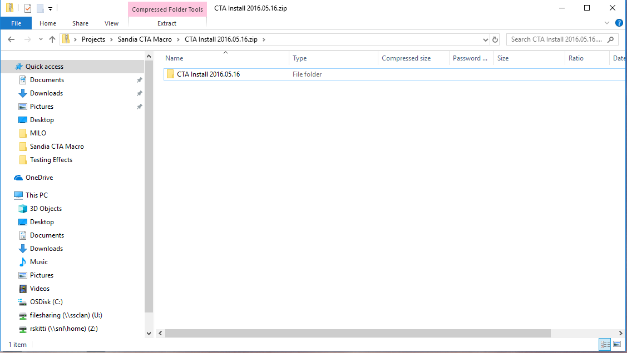
Open the file you downloaded: CTA Install 2016.05.16.zip Note: Check your Downloads folder if you can’t find this file Then, double click “CTA Install 2016.05.16”

Slide 4
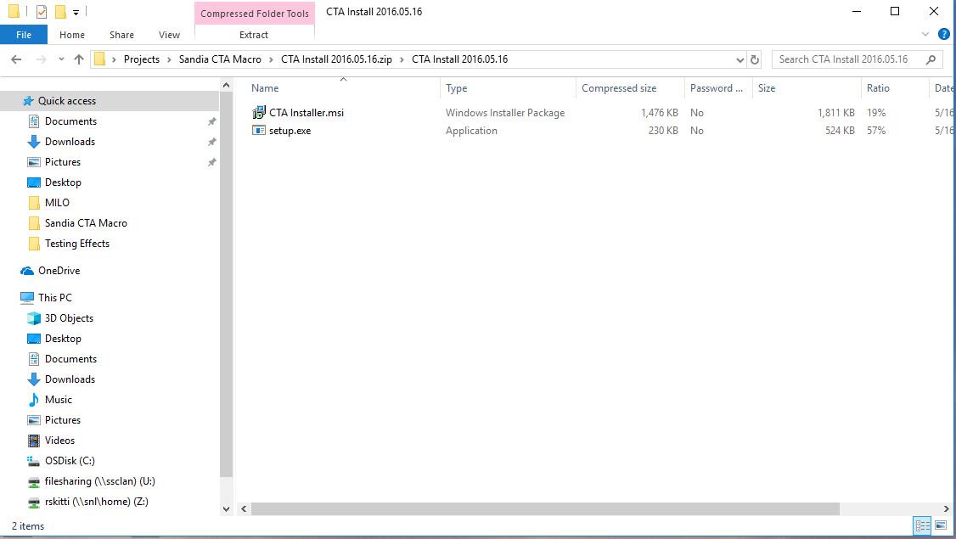
Click CTA Installer.msi

Slide 5
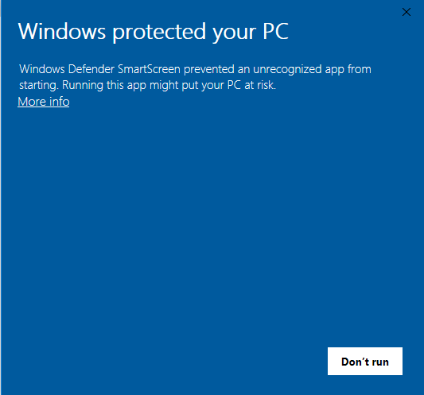
Click More info

Slide 6
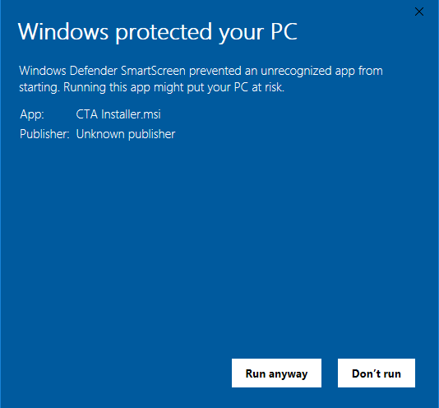
Click Run anyway

Slide 7
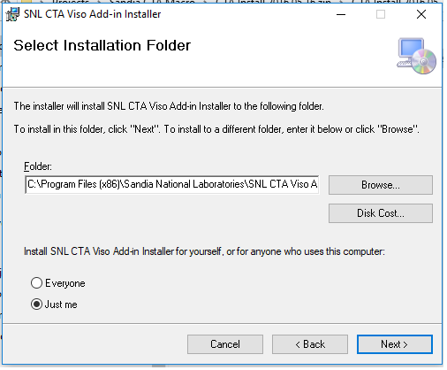
Click Next

Slide 8
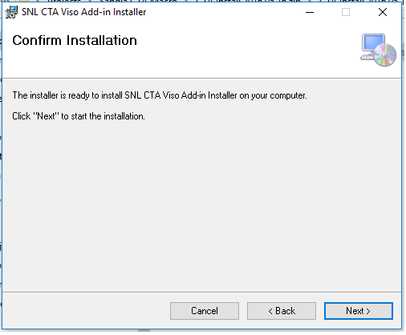
Click Next

Slide 9
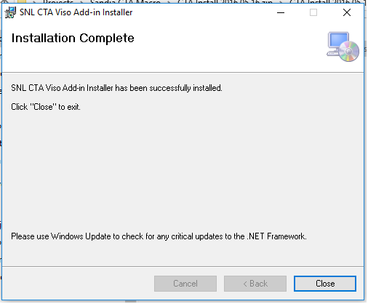
Click Close

Slide 10
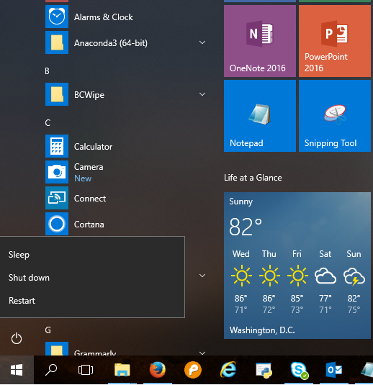
Restart your PC

Slide 11
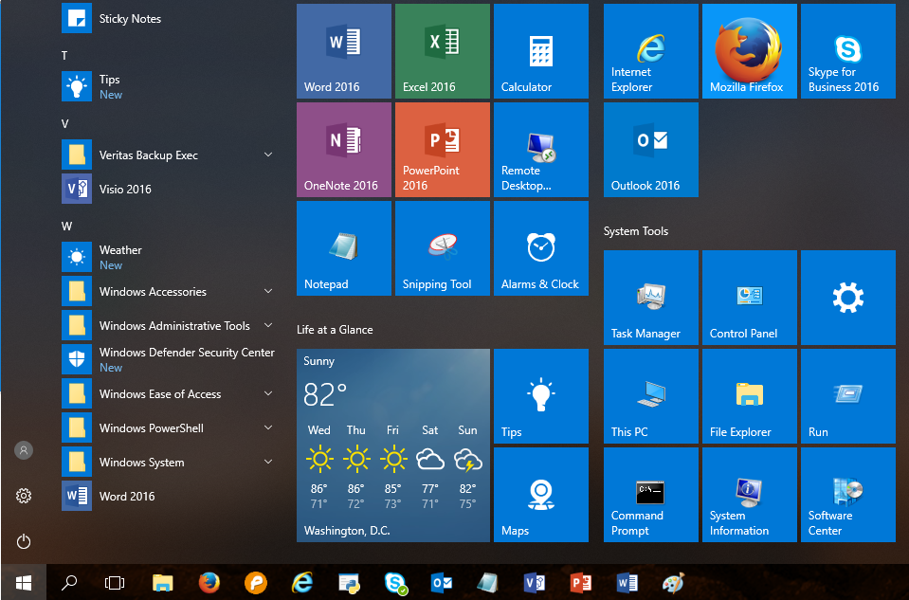
Open Visio 2016

Slide 12
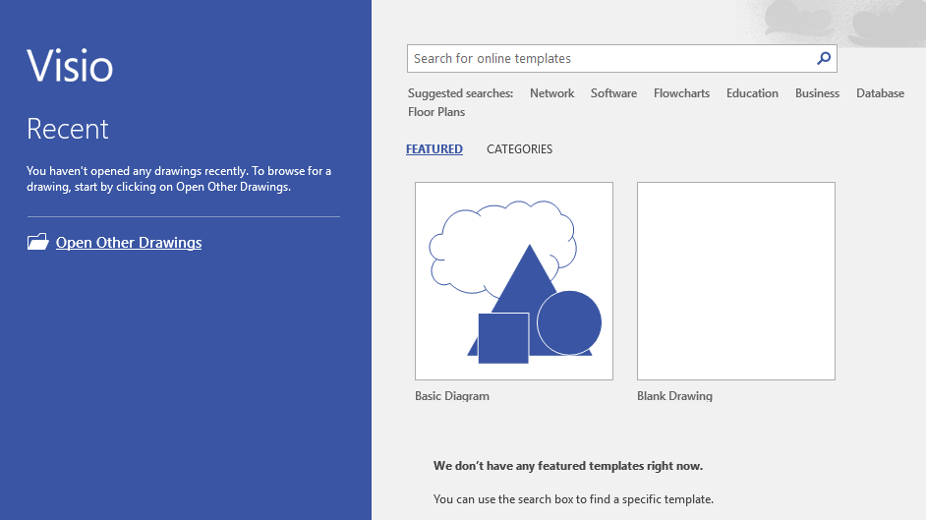
Click “Categories”

Slide 13
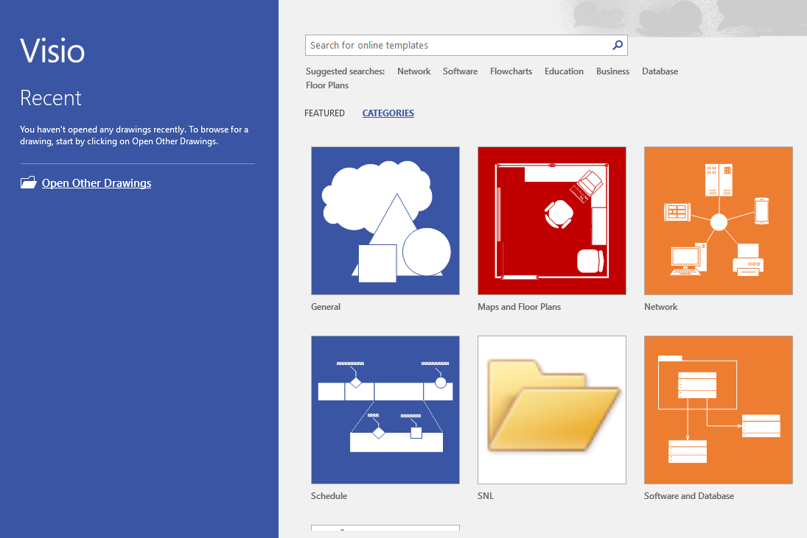
Click “SNL” (SNL stands for “Sandia National Laboratories”)

Slide 14
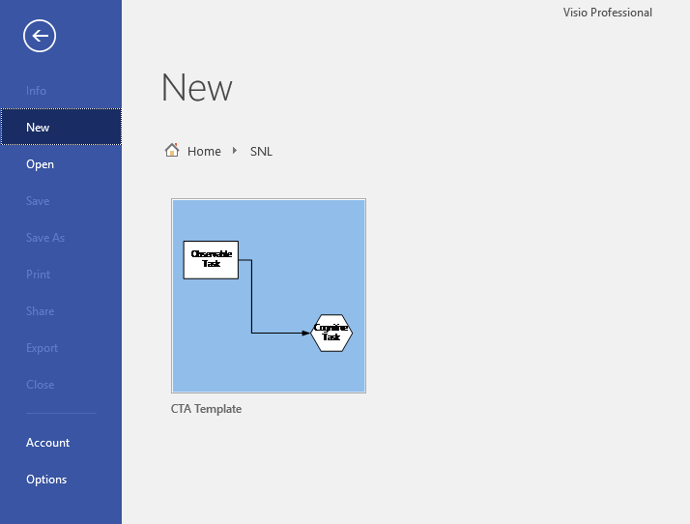
Click “CTA Template” (CTA stands for “Cognitive Task Analysis”)

Slide 15
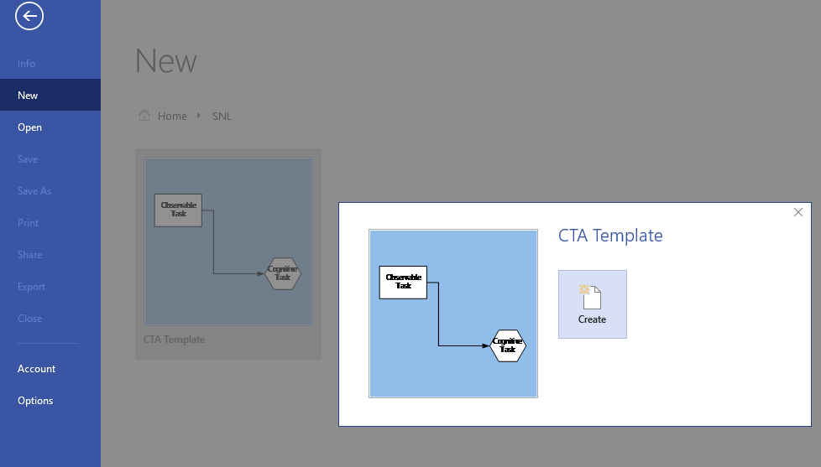
Click “Create”

Slide 16
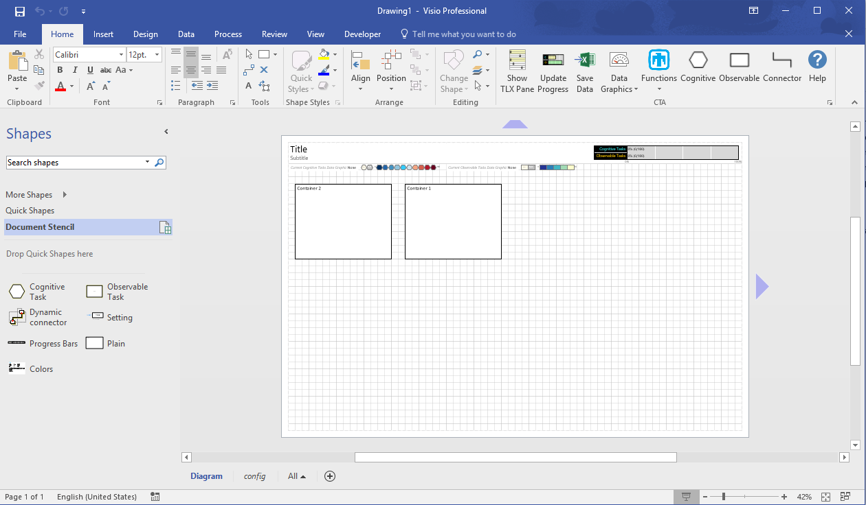
Success! This is where you will build your job analysis or cognitive task analysis, or conduct a DIF (difficulty, importance, frequency) analysis. Click “Help” for more information.

Slide 17
Make sure to click “config” at the bottom of this screen to link your Visio file to your data file before you create a diagram. Additional instructions on this process are currently being written in a user manual.

Slide 18

You can reach out to Rob Kittinger, rskitti@sandia.gov, with questions about installing this software, or if you find an error/confusion in this presentation.
If you are interested in potential modifications to the software, you can email Rubi Gemmell at rubigemmell@interarchyiq.com.
Dr. Kittinger’s research articles, which include research that used this tool, can be found at: https://www.researchgate.net/profile/Robert_Kittinger
Rob Kittinger, PhD
Sandia National Labs (Org. 9133)
Senior Member of Technical Staff
Industrial-Organizational Psychologist
Rskitti@sandia.gov
(505) 284-2452

